Slide 1
Web Application
Using Django
Part II

Slide 2
Making Pages: The Learning Log Home Page
Making web pages with Django consists of three stages:
defining URLs
writing views
writing templates
Can be done in any order but a preferred method is to define URL, write a view and then a template
Each URL maps to a view
the view function retrieves and processes the data needed for that page.
The view function often renders the page using a template, which contains the overall structure of the page.
Notes:
url defines where to find the view, the view is the content, and sends it to the skeleton (the structure of the page) which is a skeleton

Slide 3
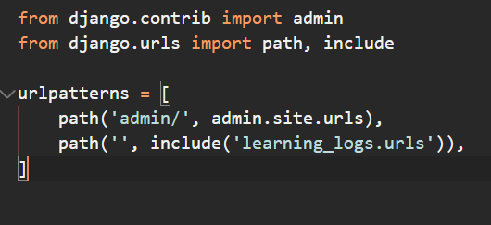
Mapping a URL
map the home page URL to something other than the default Django site
edit the default urls.py file in the learning_log folder (the project)

Slide 4
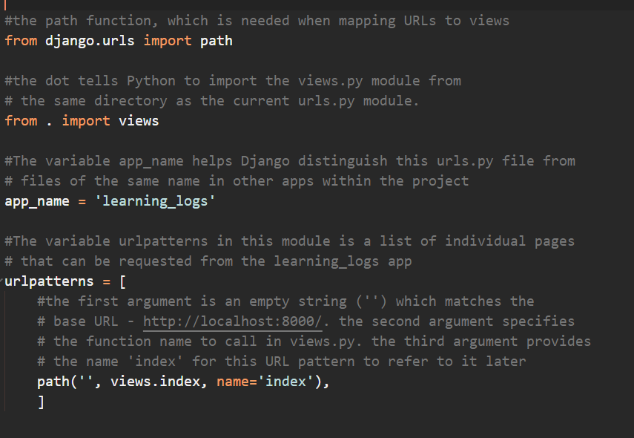
Mapping a URL
make a new urls.py file in the learning_logs folder (the app)

Slide 5
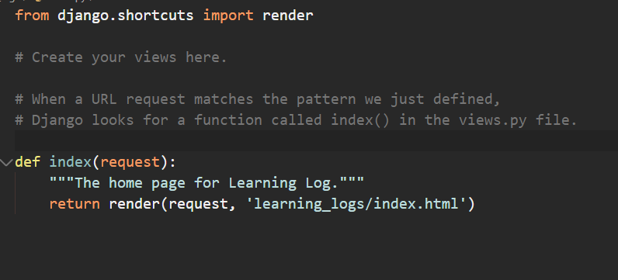
Writing a View
A view function takes in information from a request, prepares the data needed to generate a page, and then sends the data back to the browser, often by using a template that defines what the page will look like.

Slide 6
Writing a Template
The template defines what the page should look like, and Django fills in the relevant data each time the page is requested
A template allows you to access any data provided by the view.
Because our view for the home page provided no data, this template is fairly simple.
Inside the learning_logs folder, make a new folder called templates. Inside the templates folder, make another folder called learning_logs.
This might seem a little redundant but it sets up a structure that Django can interpret unambiguously, even in the context of a large project containing many individual apps.

Slide 7
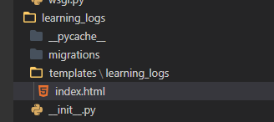
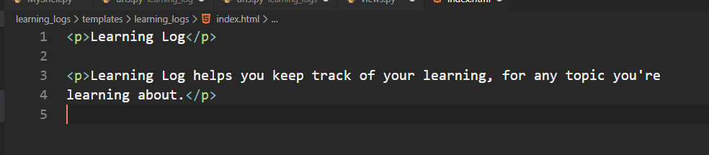
Writing a Template
Inside the inner learning_logs folder, make a new file called index.html
The path to the file will be learning_log/learning_logs/templates/learning_logs/index.html

Slide 8
NOTE
Although it might seem like a complicated process for creating one page, this separation between URLs, views, and templates works quite well.
It allows you to think about each aspect of a project separately.
In larger projects, it allows individuals working on the project to focus on the areas in which they’re strongest.
For example, a database specialist can focus on the models, a programmer can focus on the view code, and a web designer can focus on the templates.

Slide 9
Template Inheritance
When building a website, some elements will always need to be repeated on each page
write a base template containing the repeated elements and then have each page inherit from the base
For the project we would like to include a link at the top of every page that redirects the user back to the home page
create a parent template document named base.html
rewrite index.html as a child template so that it inherits from base.html

Slide 10
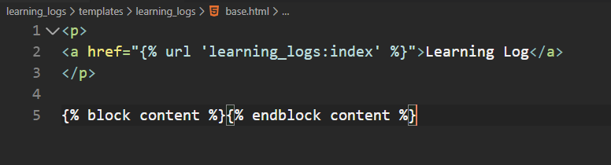
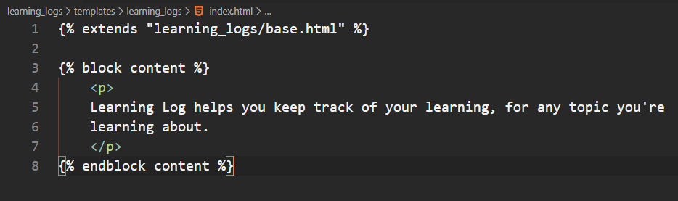
Template Inheritance
Parent Template – base.html
Child Template – index.html

Slide 11
Exercise - The Topics Page
Now that we have the basic structure, let’s try and create a ‘topics’ page
Step 1 – Add the topics url to the urls.py file (under learning_logs)
Step 2 – Define a topics function in the views.py file
Step 3 – Create the topics template topics.html that inherits from base.html

